Slide 1

Becoming Iron-Man
Needfinding
A1 Presentation
Thomas Escudero, Frieda Rong, Rickenson Robert, Kelsey Zeng

Slide 2
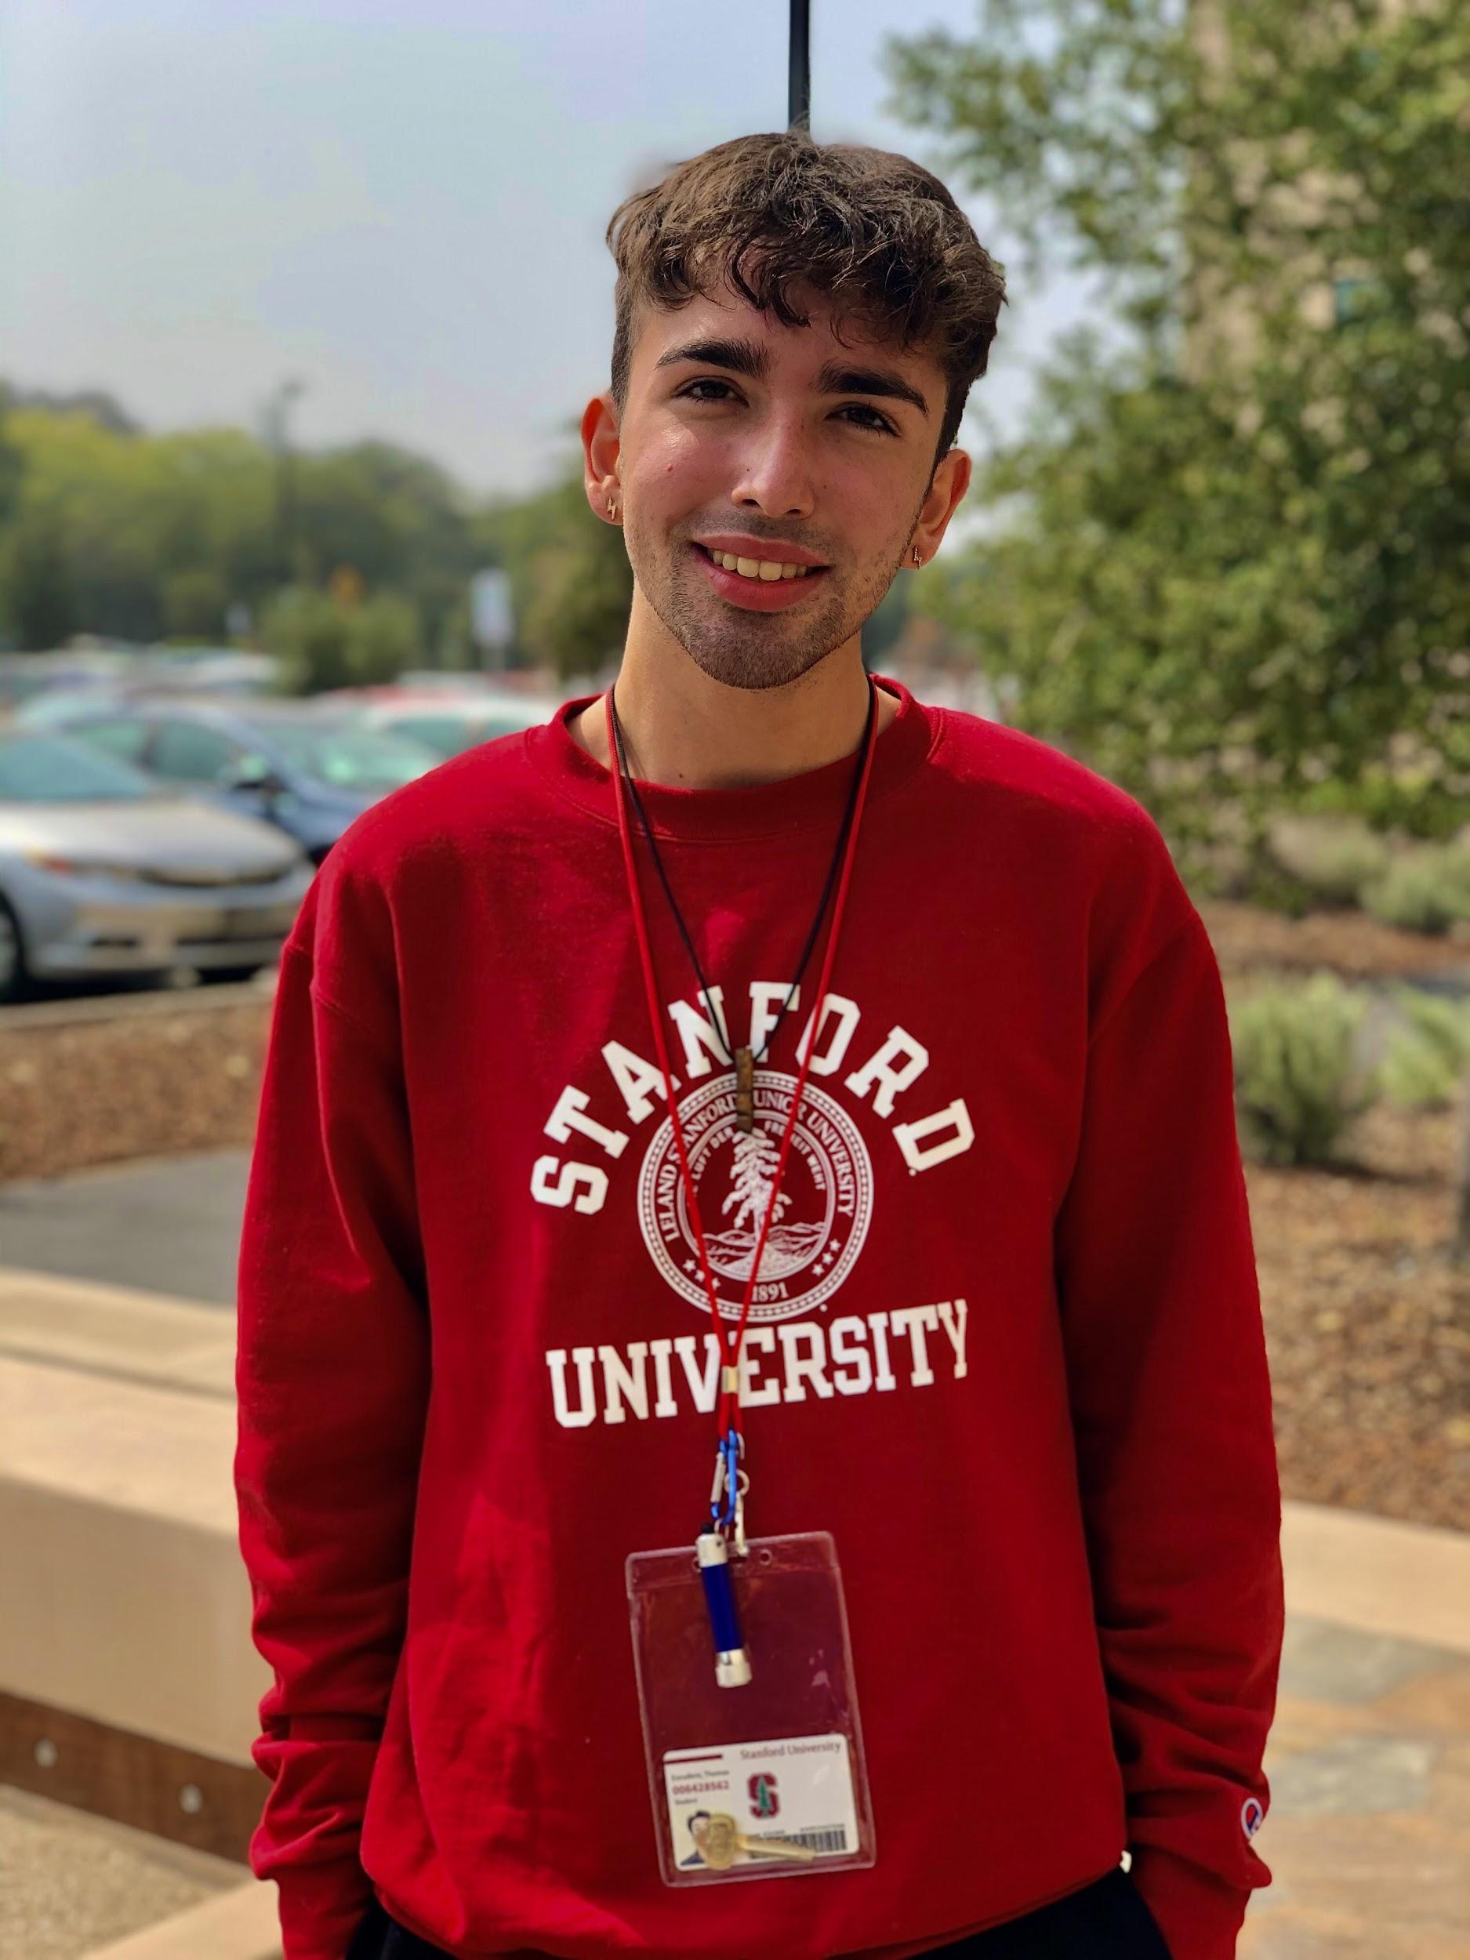
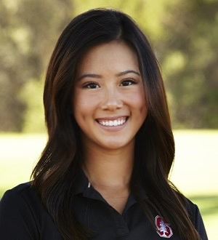
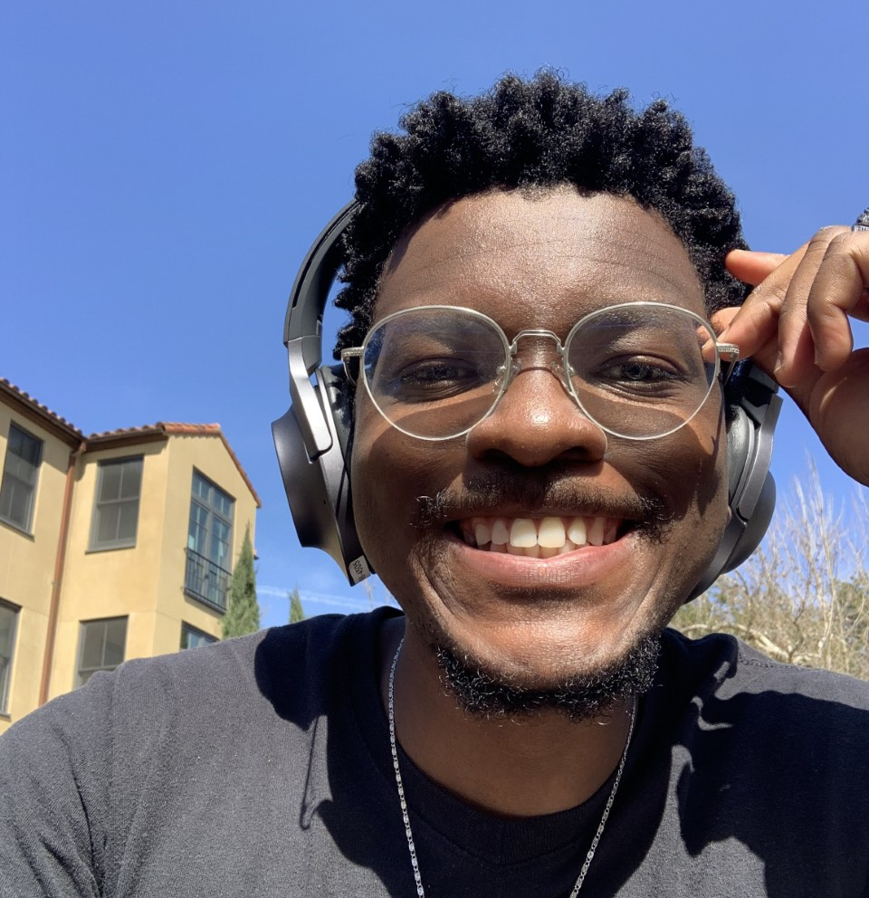
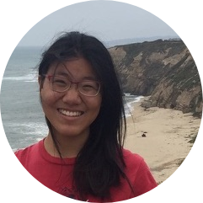
Team Intros
Thomas Escudero
Sophomore
Product Design & CS
I lived in Argentina for 3 years!
Thomas Escudero
Sophomore
Product Design & CS
I lived in Argentina for 3 years!
Kelsey Zeng
Senior
Symbolic Systems
I spontaneously adopted a bunny off craigslist
Rick Robert
Senior
CS
I taught 2nd graders intro CS on Zoom during the pandemic
Frieda Rong
2nd year PhD
CS
I did ballroom dancing with CMU while visiting Pittsburgh

Slide 3

Problem Domain

Slide 4
Enhanced Access to Information
Shazam
PlantNet
Knowledge Discovery
Google Tune
SkyView

Slide 5
Needfinding Methodology

Slide 6
Participants with different professional backgrounds, ages, and sensical abilities
Professional Backgrounds
Age
Sensical Abilities
Graphic designers, playwrights, college students, engineers, moms, teachers
Participants were young adults, up to participants that were 75 years of age
What senses do these participants use the most on a day-to-day basis?

Slide 7
EXTREME users
Users with ‘heightened’ senses, due to their professions, hobbies, etc…
Users with inherently less sense capabilities…

Slide 8
Gauging behaviors, motivations, and inspirations
Examples of when you self taught a new skill?
What are your New Year’s resolutions?
How do you stay motivated when learning something new?
What makes XYZ platform helpful?
If you could have a 6th sense, what would it be?

Slide 9
Interview Results

Slide 10

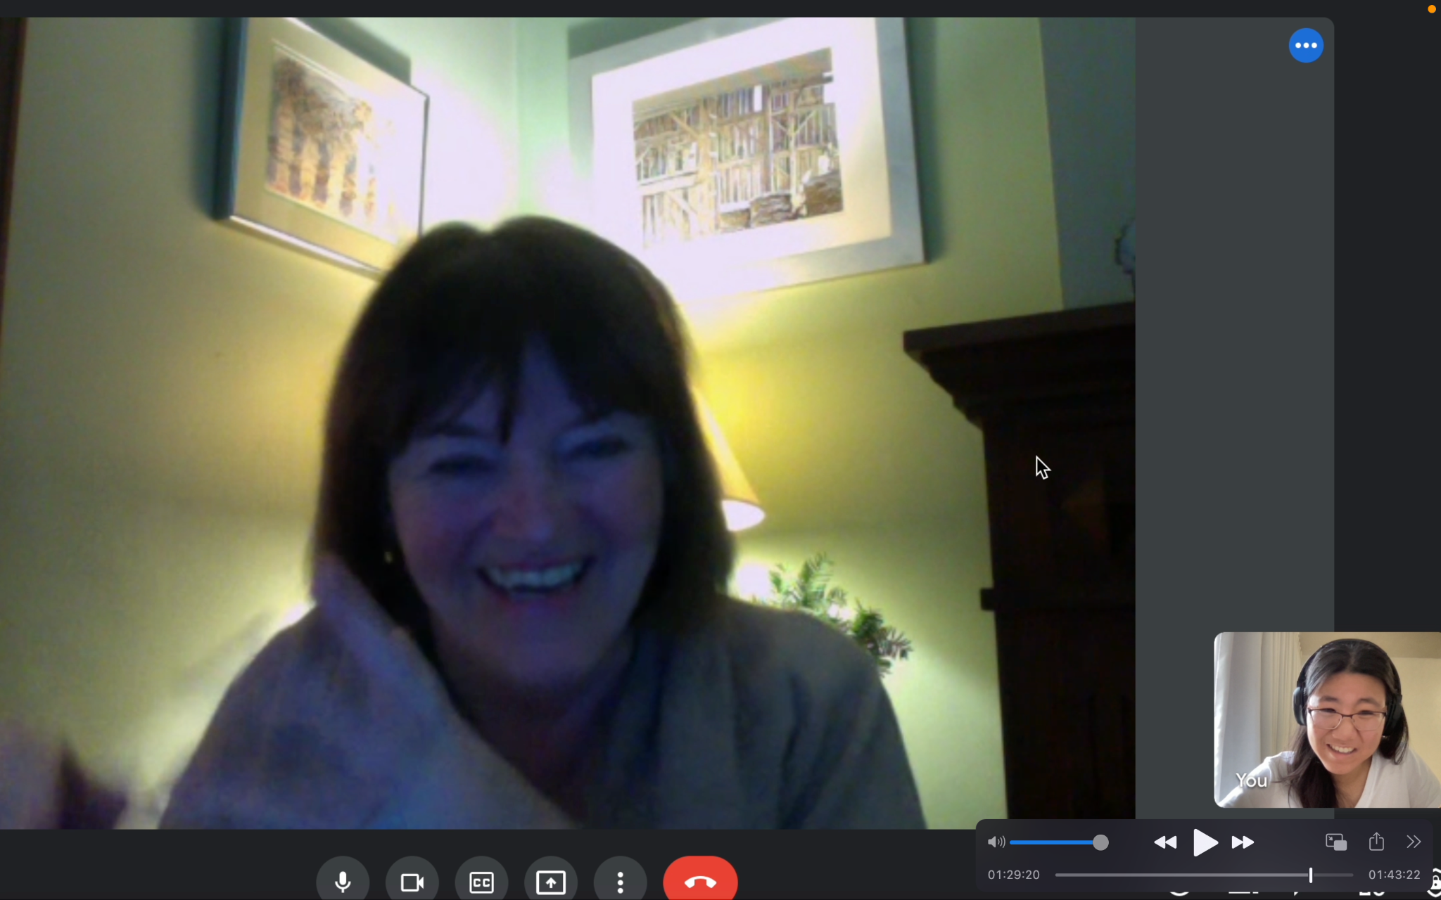
Interview Experience

Slide 11

Quotes & Surprises
“I’d love to have access to better resources more easily”
“My first exposure to media was radio…there was no TV”
“I wish I could have more discipline”
“There are 10 senses..”
“I take up a lot of time doing meaningless things”

Slide 12
Distractions & lack of discipline are primary setbacks to learning & hobby-making
Memory through sensing (kinesthesia)
Self-awareness of improvement and access to resources
Creativity with elevating the human experience
Simplicity leads to thoroughness
Key Findings

Slide 13
Analysis
Notes:
Ppl feel overwhelmed with amount of info they have…bc they have access but its hard whats actually useful
Frustrated that its difficult to find affordable and understandable resources when trying to learn something
Overchoice/choice overload/choice paralysis
Older generations dont have control issues with technology…having all these options and abilities but not doing good things with them…
Didnt focus on weaknesses that much…
Shes successful
Younger generations feel the pressure of time and constantly comoparing urself to more successful people.
Tensions…
Simplicity leads to thoroughness

Slide 14
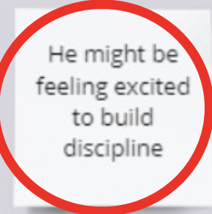
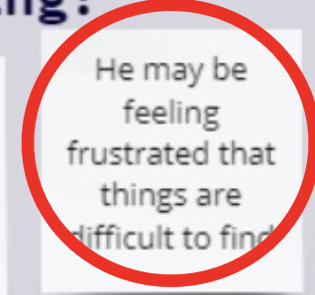
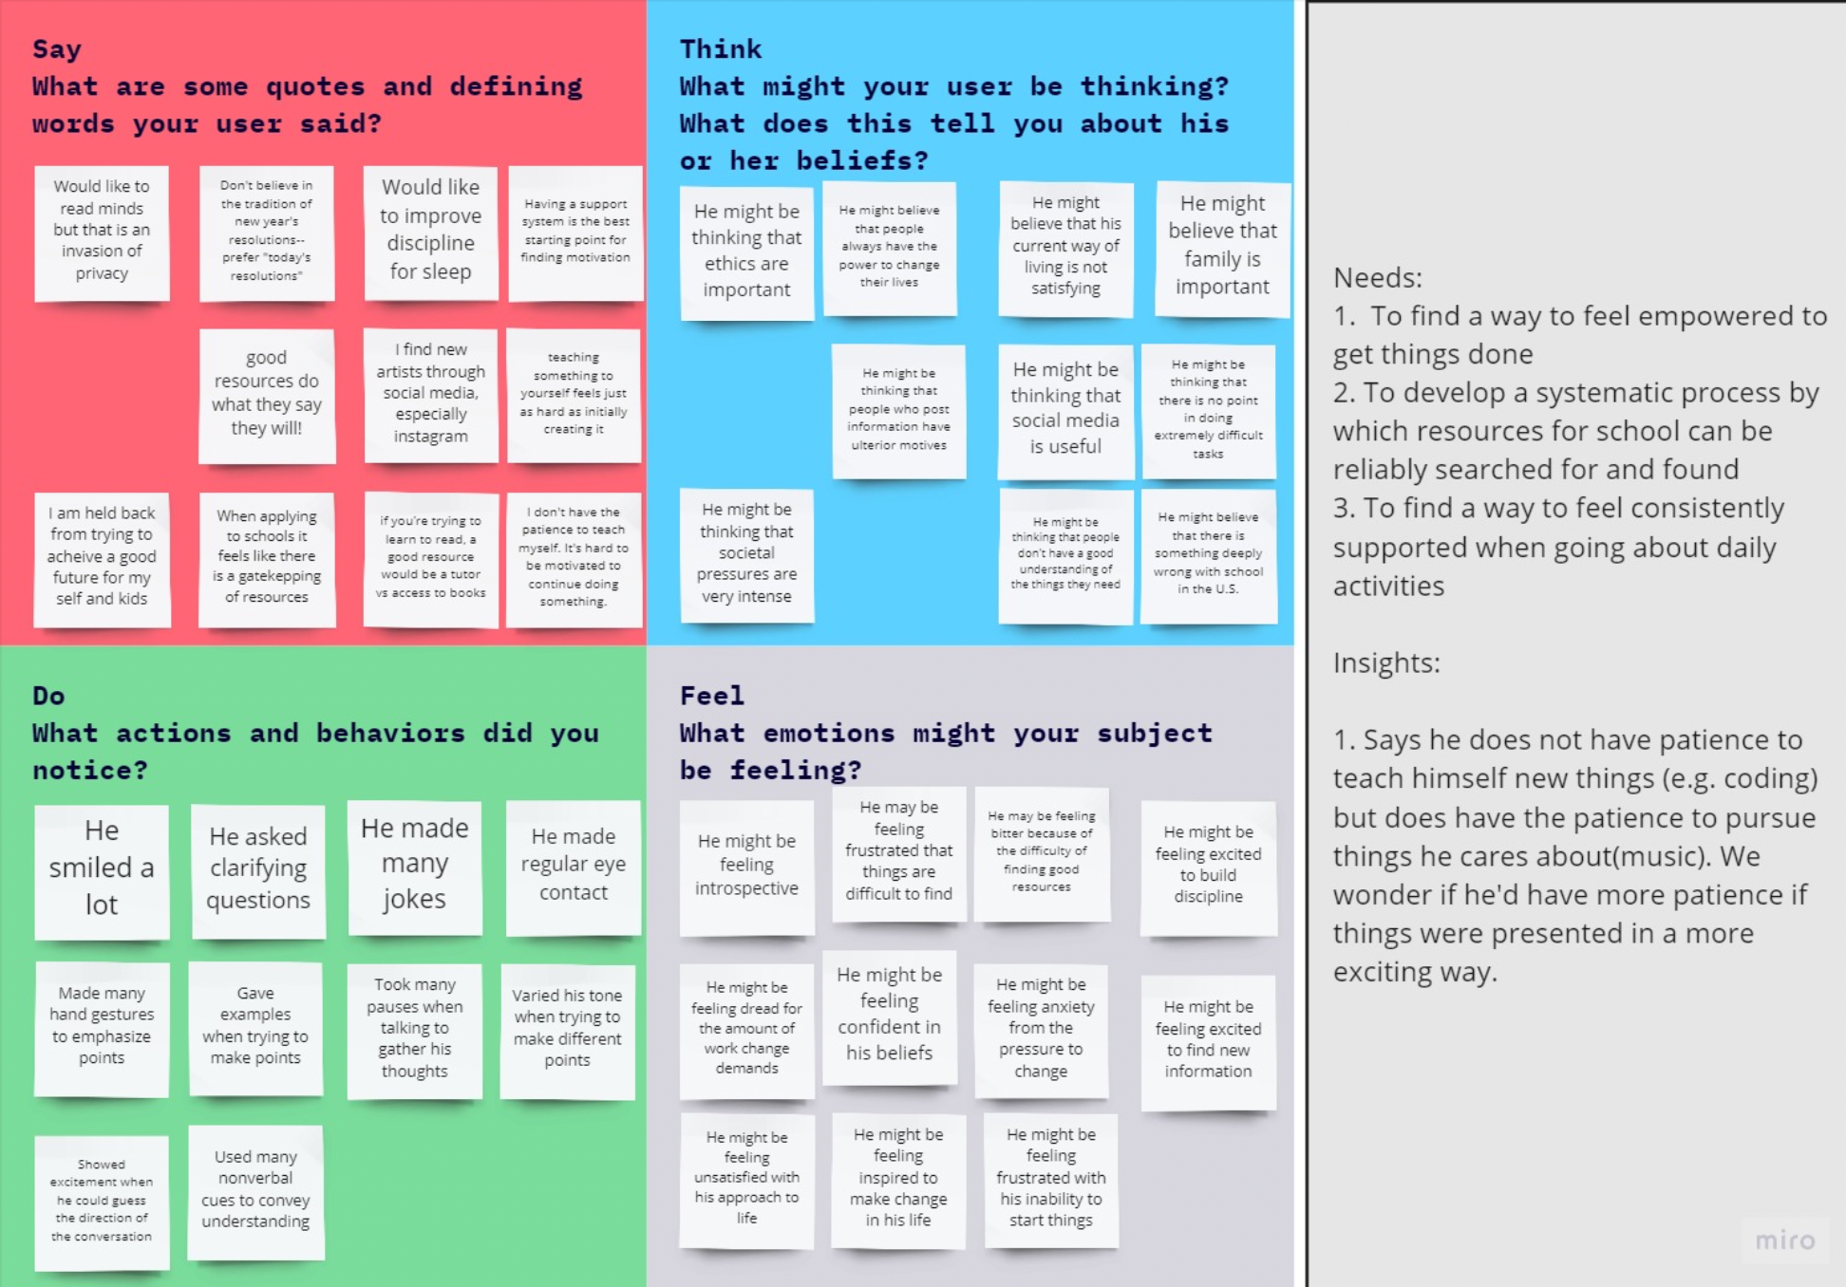
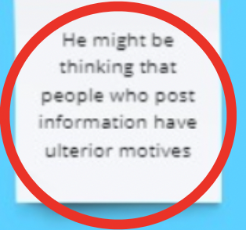
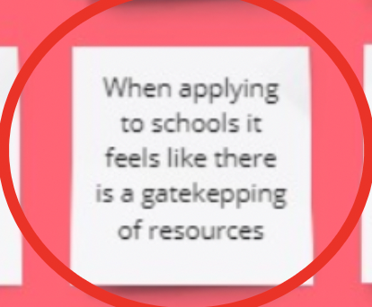
Empathy Map
Notes:
Talking about goals and motivations makes us more excited about them!

Slide 15
Tensions
Contradictions
Simplicity leads to thoroughness
Too much information, but little reliability and trust
Is current information-assisted technology helping older demographics more than younger users?

Slide 16
What Now?
How can we enhance information discovery to maintain users engaged and non-intimidated?

Slide 17
Summary

Slide 18
Brainstorming
Discussing the studio theme, problem domains, and different needfinding methodologies...
Needfinding
Investigating our problem domain, our interviewee selection process, and our interview environment
Analyzing
Transforming the needfinding data into synthesized analysis to further focus our problem domain

